Slide 1
Travel in Antarctica, A Historical Journey to the Magnetic South Pole, 4 Months in 1908-1909
Copyright: This resource is provided free by CoolAntarctica.com, you’re welcome. It cannot be distributed by any other means, believe it or not people sometimes lift free resources and distribute them pretending they have been allowed to or even sell them as their own – I know! It’s shocking! If anyone asks you for payment for this or if you get it but not from CoolAntarctica.com, please email danthwhaler@gmail.com and the ghost of Whaler Dan will exact retribution on the scurvy dogs.
This copyright notice must appear wherever this material is used. Any queries please email

Slide 2
For four months from the 5th of October 1908 to the 2nd of February 1909 Edgeworth David, Douglas Mawson and Alistair Mackay made a manhauling journey of 1,260 miles (2,027 km) from their base hut to the South Magnetic Pole and back again as a part of Ernest Shackleton's 1907-09 British Antarctic Expedition. From the 1st week of November this journey took place in 24 hour daylight.

Slide 3
Early expeditions used "depot laying" as a way of travelling further. A depot was a place where food and fuel were left so that those on the main journey didn't have to carry it all with them. Laying depots and returning to base each time greatly increased the overall travelling needed to allow the main party to travel relatively lightly, typically many more men would be involved in depot laying than went on the main journey.
The expedition took the first motor car to be used in Antarctica, here it is being used to lay supply depots before the main journey began.
It struggled on anything other than very good surfaces and broke down frequently (often from overheating!) so wasn’t used far from base.

Slide 4
The route was west from the expedition base, across seasonal sea ice, north along the coast on seasonal sea ice for ease of travel, then turn inland and head for the Magnetic Pole. Part of Shackleton’s letter to Professor Edgeworth David setting out his instructions: DEAR SIR, — The sledge-party which you have charge of consists of yourself, Douglas Mawson and Alistair Mackay. You will leave winter quarters on or about October 1, 1908. The main objects of your journey are to be as follows: (1) To take magnetic observations at every suitable point with a view of determining the dip and the position of the Magnetic Pole. If time permits, and your equipment and supplies are sufficient, you will try and reach the Magnetic Pole.
* Magnetic
South
Pole
* Met the Nimrod here
* Start

Slide 5
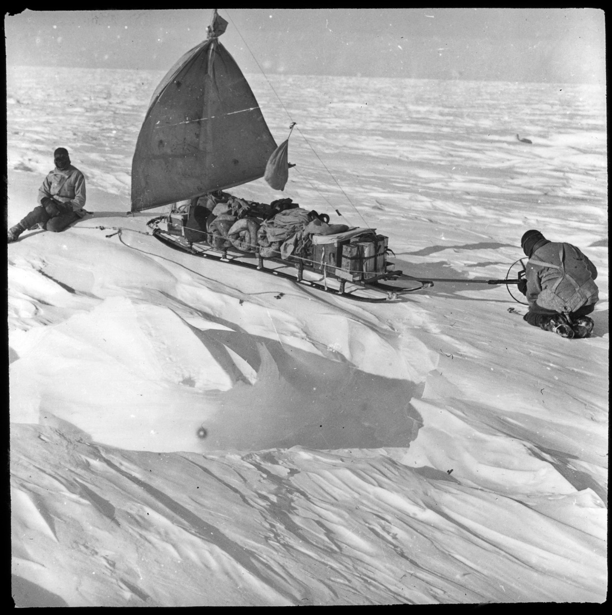
October 17 - The day being calm, clear and free from falling or drifting snow, for the first time, we turned our sleeping-bag* inside out to air it in the sun. The reindeer fur inside the bag had become much encrusted with ice, chiefly the result of the freezing of our breath. The wind was now sufficiently strong to pull both sledges together by sail. That night I experienced a rather bad attack of snow-blindness, through neglecting to wear my snow goggles regularly. *note – just 1 big sleeping bag

Slide 6
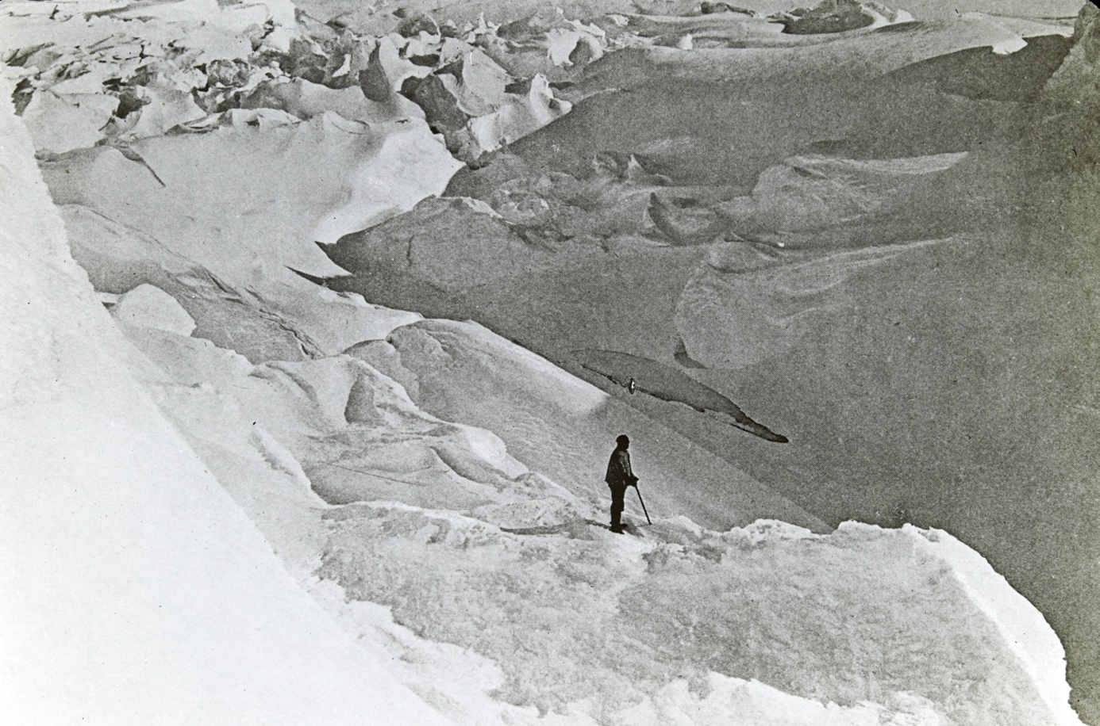
November 1 - ...breakfast was ordinary hoosh and seal meat. After discussion we decided that our only hope of reaching the Magnetic Pole was to travel on half rations from our present camp to the Drygalski Glacier. Mawson emphasized that we must keep six weeks of full rations for our inland journey to and from the Pole. We would be on half rations for about a hundred miles. We knew that there was some danger in this, but we felt we had got so far with the work entrusted to us by Shackleton, that we could not honourably turn back. We each wrote farewell letters to those who were nearest and dearest. The following morning, we were up at 4.30 a.m. We left the letters at a cairn in case we did not return.

Slide 7
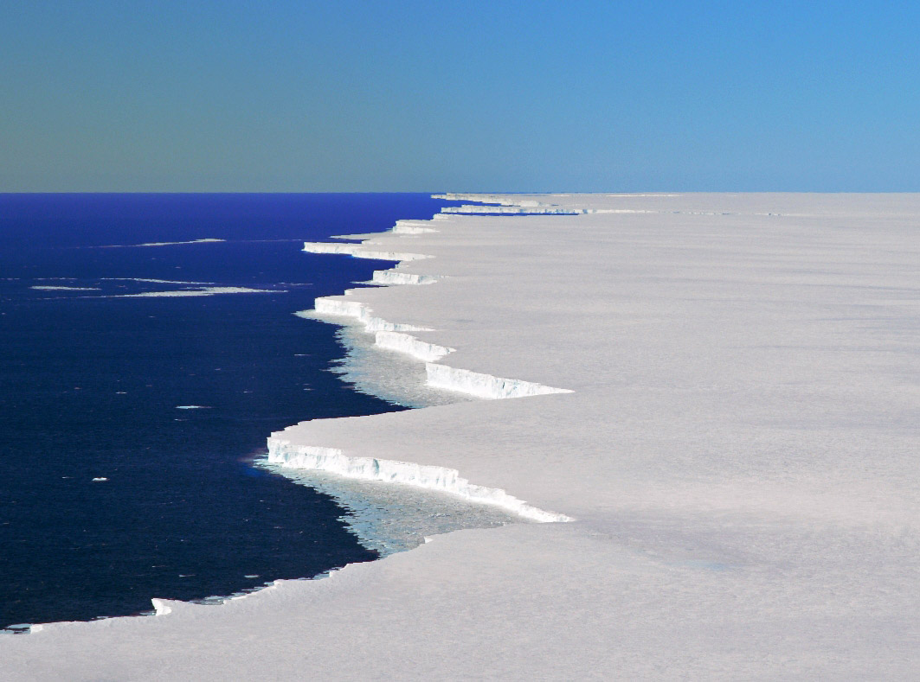
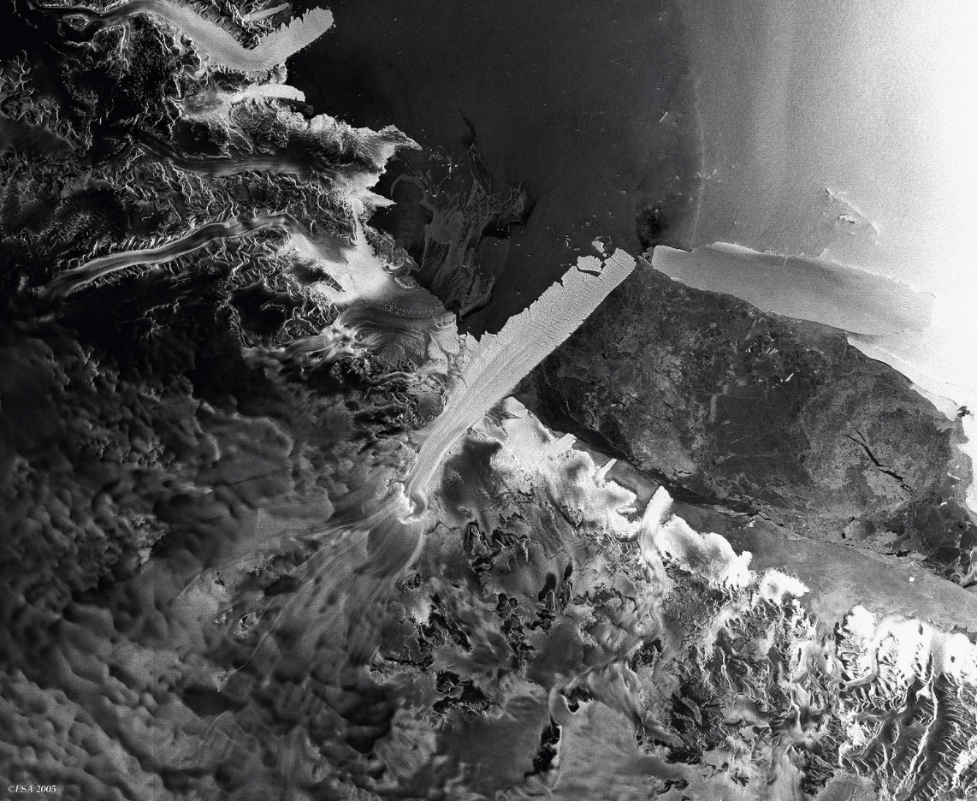
December 5-6 - Soon after midnight, we left our camp on the south side of the Drygalski Glacier (20 miles across), and struck across the high ridges of blue ice.

Slide 8
December 14 - ... we were still busy preparing for the great trek on the morrow. Mackay was busy cooking Emperor penguin and seal meat for the plateau journey (inland). We trudged through soft thawing snow with here and there shallow pools of water on the surface of the ice. This saturated our socks, which froze as the temperature fell during the night.

Slide 9
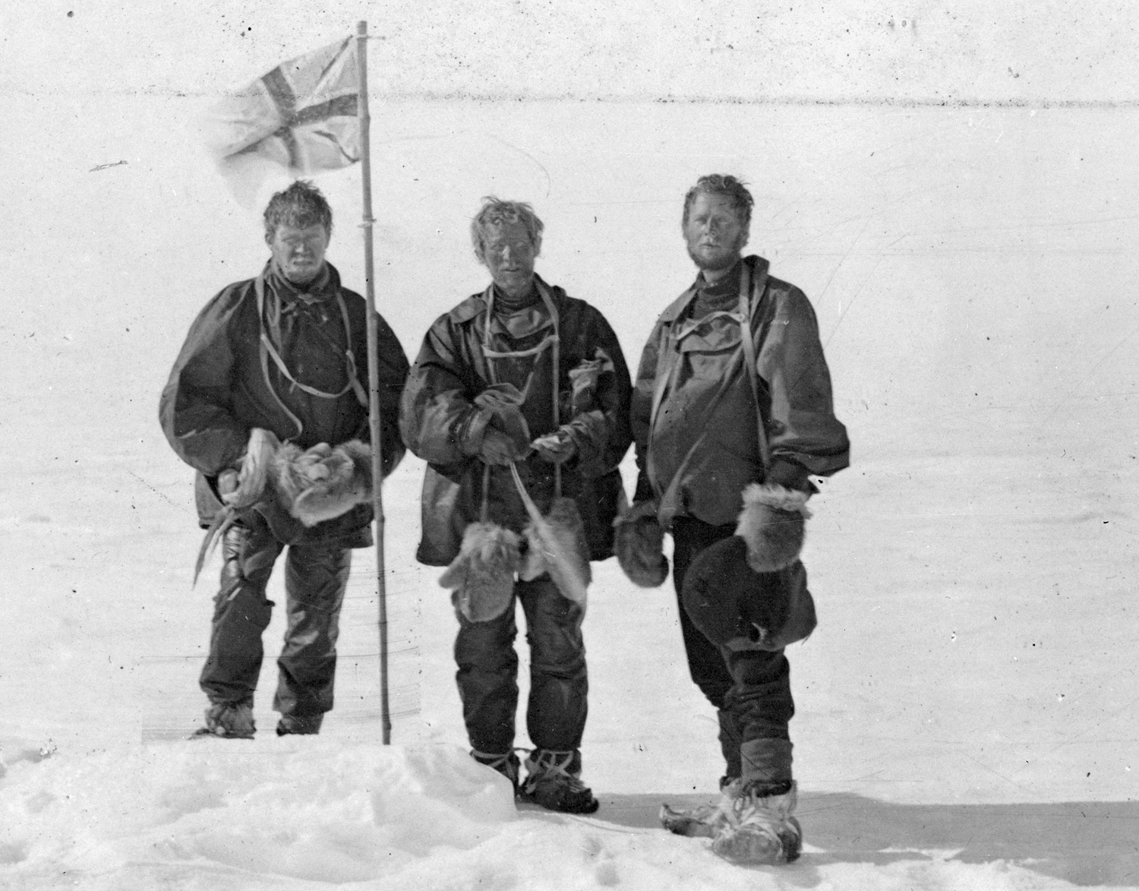
January 16 - Up about 6 a.m., after breakfast we pulled on our sledge for two miles and depoted all our heavy gear and equipment. .... We walked five miles in the direction of the Magnetic Pole, to the position calculated by Mawson. Mackay and I fixed up the flag-pole. We bared our heads and hoisted the Union Jack at 3.30 p.m., following Shackleton's instructions I said, "I hereby take possession of this area now containing the Magnetic Pole for the British Empire." I fired the trigger of the camera by pulling the string. Then we gave three cheers for his Majesty the King.

Slide 10
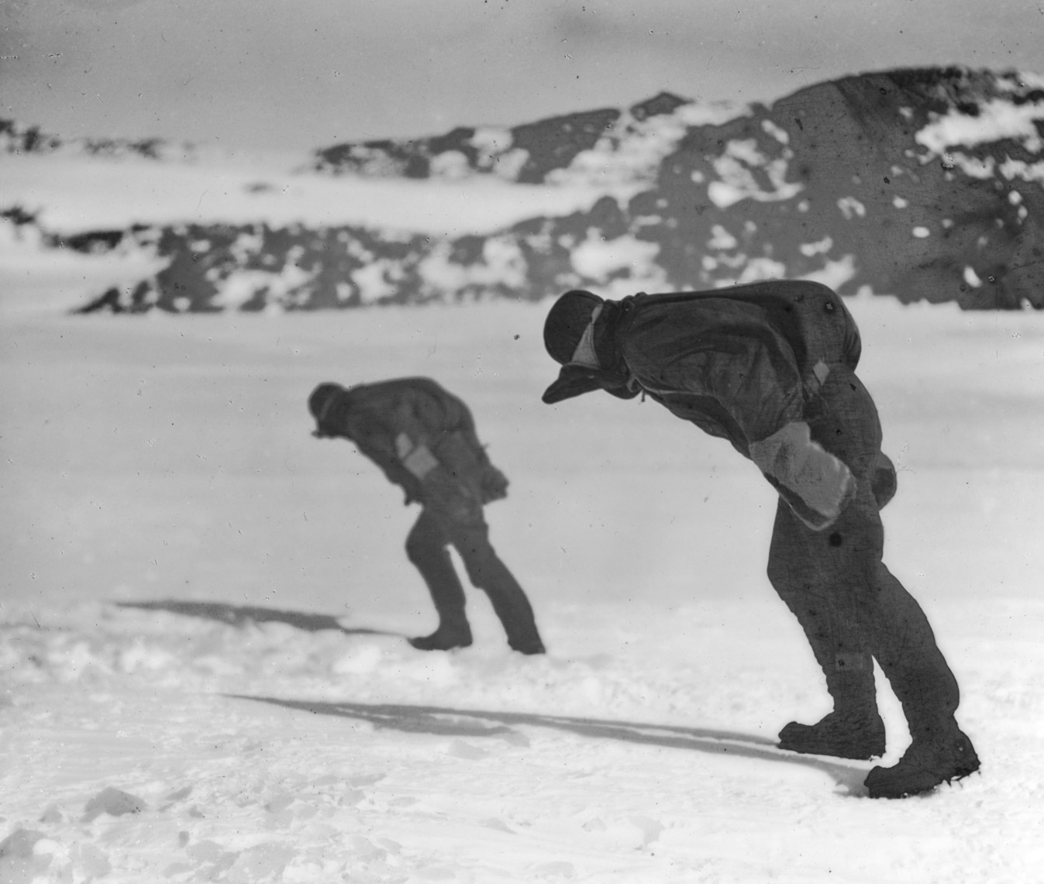
January 28 - A blizzard was blowing, and after breakfast we had much difficulty in the cold wind in getting up the mast and sail. Mackay, who usually did the greater part of this work, got his hands rather badly frost-bitten before our preparations were completed. January 30 - We found that, owing to the alternate thawing and freezing of the snow at our depot, our ski-boots were almost filled with solid ice. The work of chipping out this ice proved a slow and tedious job, and we did not get started until about 11 a.m.

Slide 11
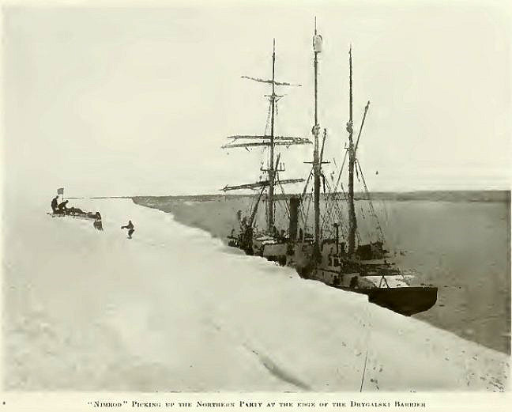
February 3 - Mawson spoke first, roaring out, "A gun from the ship!" and dived for the tent door... A sudden shout from Mackay called me back to earth, "Mawson's fallen into a deep crevasse. Look out, it's just in front of you!“ ... Mackay shouted to those on board, "Mawson has fallen down a crevasse, and we got to the Magnetic Pole.“ The crevasse was bridged with a suitable piece of sawn timber, and Davis (first officer of the ship, Nimrod), promptly had himself lowered down the crevasse. He transferred the rope to Mawson, and with a long pull and a strong pull and a pull altogether, the company of the Nimrod soon had Mawson safe on top, with just a slightly bruised back. The rope was cast free from Mawson, and let down again for Davis, and presently he, too, was safely on top.

Slide 12
February 3 (cont) - We heard of the narrow escape of Armytage, Priestley and Brocklehurst, when they were being carried out to sea, with only two days' provisions, on a small ice-floe surrounded by Killer whales; and how, just after the momentary grounding of the floe, they were all just able to leap ashore at a spot where they were picked up later by the Nimrod. Pleasantly the buzz of our friends' voices blended itself with the gentle fizzing of steam from the Nimrod's boiler, and surely since the days of John Gilpin "were never folk so glad" as were we three.

